Slide 1

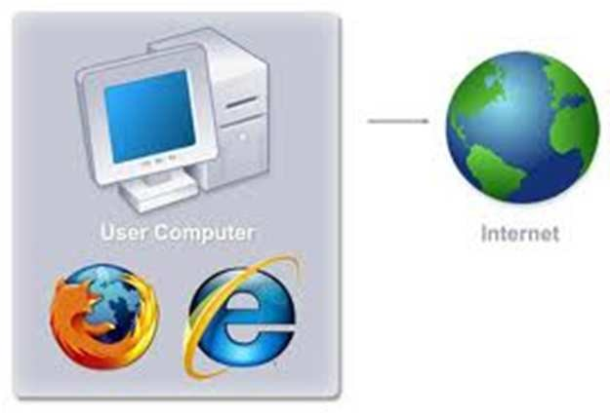
COM 210
Structured Programming
Kariuki Paul
memekariuki@gmail.com

Slide 2
IDEs
Integrated Development Environment
They have all the tools integrated
  Editor
  Compiler
  Debugger
  [Publisher]
  [Documentaries ]

Slide 3
Famous IDEs
Microsoft Visual Studio 2005
Dev-Cpp 5
Emacs/Vim + gcc + gdb
Eclipse IDE 3.2
Borland Turbo C / C++ Builder
Metrowerks CodeWarrior \
KDeveloper

Slide 4
Microsoft Visual Studio 2005
It’s from Microsoft.
Uses Microsoft .net C/C++ compiler
Based on .net 2
Also support other language [ basic, J#, C#, Pascal! … ]
Too expensive! But first class IDE.
Complete suite [ compiler, framework, Editor, Debugger, Publisher, MSDN, etc.]
Compiler command:
  cl main.c
  cl /c main.c

Slide 5
Dev-CPP
Free-OpenSource-GCC base [ included ]
Compatible with gcc & gdb
For windows!
CVS support

Slide 6
Eclipse
Sponsored by IBM
IDE for Java ( mostly )/ Cpp/ Python/ GWT …
For both Windows and Linux

Slide 7
TurboC / C++Builder
Made by Borland
Small & Easy but inefficient
For DOS, although it runs under windows too.
The borland company was bought by Microsoft, nowadays a new version of C++Builder has been released.

Slide 8
Writing C Programs
A programmer uses a text editor to create or modify files containing C code.
Code is also known as source code.
A file containing source code is called a source file.
After a C source file has been created, the programmer must invoke the C compiler before the program can be executed (run).

Slide 9
3 Stages of Compilation
Stage 1: Preprocessing
  Performed by a program called the preprocessor
  Modifies the source code (in RAM) according to preprocessor directives (preprocessor commands) embedded in the source code
  Strips comments and white space from the code
  The source code as stored on disk is not modified.

Slide 10
3 Stages of Compilation (con’t)
Stage 2: Compilation
  Performed by a program called the compiler
  Translates the preprocessor-modified source code into object code (machine code)
  Checks for syntax errors and warnings
  Saves the object code to a disk file, if instructed to do so
    If any compiler errors are received, no object code file will be generated.
    An object code file will be generated if only warnings, not errors, are received.

Slide 11
3 Stages of Compilation (con’t)
Stage 3: Linking
  Combines the program object code with other object code to produce the executable file.
  The other object code can come from the Run-Time Library, other libraries, or object files that you have created.
  Saves the executable code to a disk file. On the Linux system, that file is called a.out.
    If any linker errors are received, no executable file will be generated.

Slide 12
Program Development Using gcc
Editor
Source File pgm.c
Preprocessor
Modified Source Code in RAM
Compiler
Program Object Code File pgm.o
Other Object Code Files (if any)
Linker
Executable File a.out

